Slide 1
Volunteer Orientation 2026
Oaklawn Hospital

Slide 2
Agenda
Organizational Chart
Active Assailant Training
HIPAA Training
Safety On-Site Training
Infection Prevention& Control: Basics Training

Slide 3
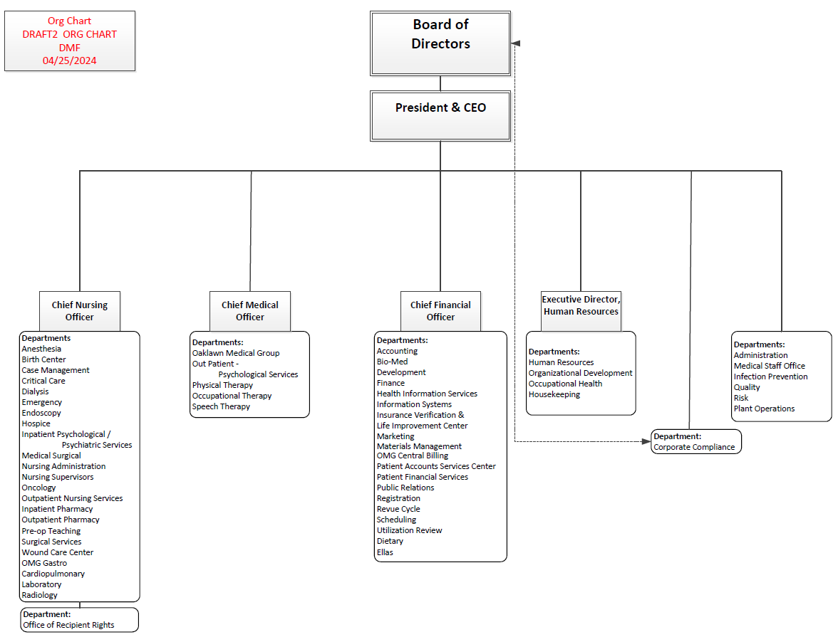

Slide 4
Active Assailant Training

Slide 5
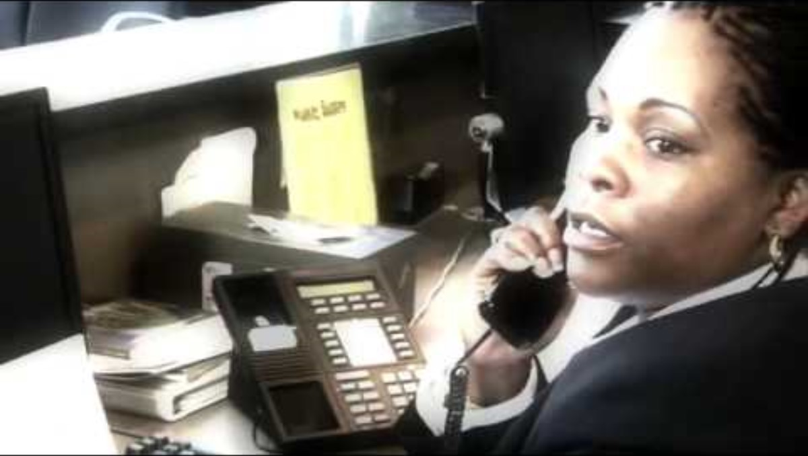
It will start like any other day!

Slide 6
Health Care Violence
While many assaultive events can occur in a hospital or clinic setting, such as verbal threats of violence or death, to pushing and shoving, to assaults with weapons, this CBL will be focusing on a much more unexpected event, an active shooter or assailant. These events are low probability events, yet ones with very significant consequences.
Yet different, every violent event requires the same set of skills to navigate.

Slide 7
Health Care Violence: Preparation
These are low frequency events; however, your actions will not be based on repetitive skills, muscle memory, or common tasks. Take the time to learn more about active assailant events, to better understand the potential options you may have in the event one occurs at your worksite.
In addition to preparing yourself, actively engage your co-workers in active assailant response. Discuss the layout of your building, your potential escape routes, designate safe rooms and research in advance the objects in your work area that could be used as distraction devices on any assailant you may encounter.

Slide 8
Health Care Violence: Plan
Develop a personal plan on how you would escape from the building; how you would hide or barricade yourself in your work area, and how (and with what) you would defend yourself if you were confronted by someone who may harm you.
Work with your supervisor and team on developing a specific work area, department, or practice plan, that will be unique to your situation and can be shared with all employees.

Slide 9
Health Care Violence: Situational Awareness
Your personal safety, as well as the safety of those people in your care, ultimately depends on you. You must remain vigilant in the situations around you. This means:
Knowing if your work area is secure. Are the doors locked, are the blinds closed, are the safety and security devices operating properly?
Know your population. Who is in my work area, and why? Are they wearing a badge? Are they a known risk or have they made threats or been violent in the past? Are they acting normal, or is something out of place?
Be vigilant. Learn about your surroundings. Identify areas of concern. Watch for potential risks. Avoid situations that may be dangerous or could cause harm. Do not take unnecessary chances.

Slide 10
Active assailant Response
The number of Active assailant events are increasing in the United States.
Assailants are getting bolder, and more creative in their methods of attack.
A key part of preparation for an event is knowing what to do if you find yourself confronted by a shooter.
Active shooter events are chaotic and scary. It’s easy to get overwhelmed. Proper preparation and training ensure that you’ll be able to react reflexively to protect yourself and others.
Avoid, Deny, Defend, developed at the ALERRT Center at Texas State University, is a method of training to rapidly respond to dangerous active shooter events.
‘Hiding and hoping’ isn’t a very effective strategy, Avoid Deny Defend® has been developed as an easy way to remember what to do.

Slide 11
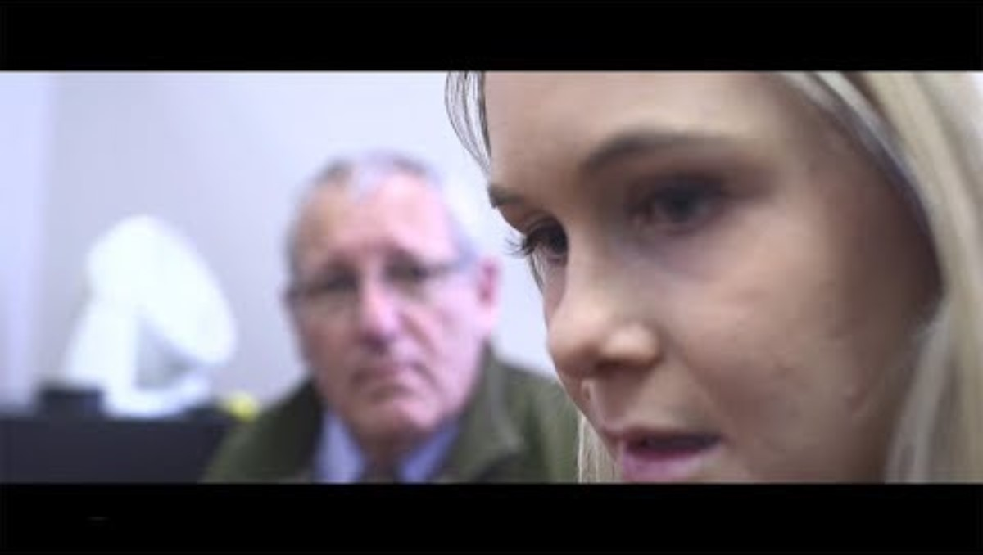
Active Shooter-Options for Consideration

Slide 12
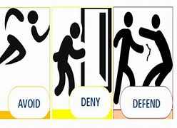
AVOID | DENY | DEFEND
RUN | HIDE | FIGHT

Slide 13
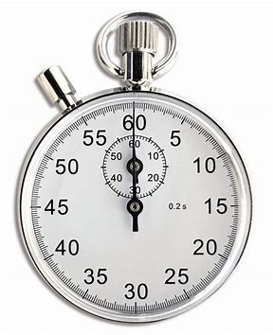
Time
Research has shown that many attack events are over before law enforcement arrives on scene.
The average law enforcement response time is three to eight minutes.
Individuals who find themselves in such an event must be prepared to take immediate action to save their own lives (or the lives of others) before law enforcement arrives.

Slide 14
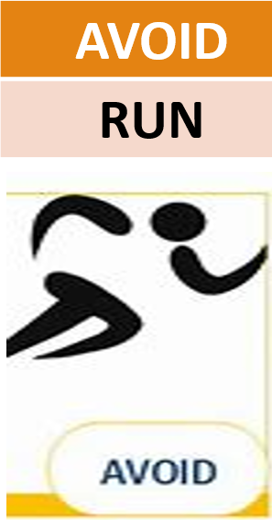
AVOID (RUN) starts with your state of mind. Maintain a keen sense of situational awareness no matter where you are. Active events can occur anywhere.
Move away from the source of the threat as quickly as possible.
The more distance and barriers between you and the threat, the better.
The best way to mitigate the risk of harm during an active assailant situation is to avoid confrontation altogether. Fleeing the scene as safely, quickly, and quietly as possible is the best way to evade contact with the assailant.
Become familiar with your floor layout plan and/or escape routes and nearest emergency exits.
Identify alternate exits for areas you spend a lot of time in. If the assailant is blocking the main entrance, you need to make sure you can quickly move to the alternative exit.

Slide 15
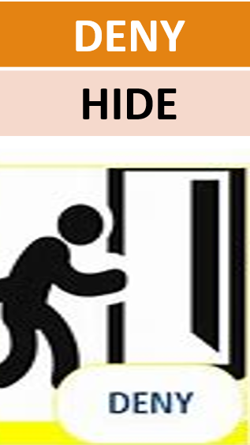
DENY (HIDE) when getting away is difficult or maybe even impossible. If you can’t leave the building safely and find yourself confined to one area such as an exam room, you need to deny the assailant access to your location.
Keep distance between you and the source of the threat.
Create barriers to prevent or slow down a threat from getting to you.
Turn the lights off and silence your phone.
Remain out of sight and quiet by hiding behind large objects.

Slide 16
DENY (HIDE) Deny Access to Your Location
Find a room with a locking standard commercial door (metal frame with solid wood core is best).
Other possible places to shelter include a closet, office, copy room, break room, bathroom or any other room that has a sturdy locking door.
Once in the room, occupants should barricade the door with as many heavy items as they can. Look around the room and pile anything heavy against the locked door. Use computer cords to help tie items into place.
Desks, copiers, chairs, tables, books, filing cabinets, break room appliances and heavy items could help blockade the entrance and deter an active shooter.
Even if the door locks or has a key card for entrance, barricade the entrance. Don’t rely on just the lock to keep the assailant out.

Slide 17
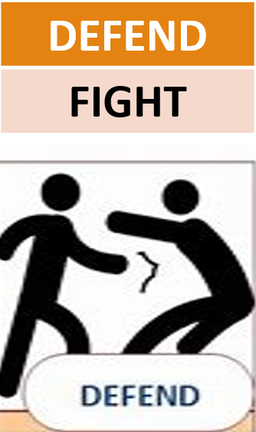
DEFEND (FIGHT) DEFEND (Fight) because you have the right to protect yourself.
If you cannot AVOID or DENY, be prepared to DEFEND yourself.
Be aggressive and 100 % committed to your actions.
Do not fight fairly. THIS IS ABOUT YOUR SURVIVAL.
Be creative and remember you are fighting for your life.

Slide 18
Defend Yourself as a last resort if faced by the assailant
If you are near the active assailant or are confronted by them, defending yourself by attacking can save your life and the lives of others. When faced with imminent danger, you must fight with all of the strength, anger, and ferocity that you can muster.
Research has shown that approximately 20% of would-be attackers are subdued by their intended victims. By launching an unexpected counterattack, you send the assailant into fight, flee, or freeze mode. You could stop and detain the shooter or just scare them off with your actions.
When attacking, look around your surroundings for an improvised weapon. Coffee pots, scissors, canned food, staplers, fire extinguishers, or other heavy objects all make good weapons. Discuss plans with coworkers ahead of time and work together to attack the assailant.
If your defense technique distracts or otherwise impedes the assailant, be prepared to run.

Slide 19
Understanding and Preparing for Police Response
Law enforcement works off priorities during an active shooter call. Their first priority is to move in, bypassing the wounded and confronting the shooter.
Try to understand the scene from the officers’ points of view. They do not know who you are and have been trained to treat everyone as "unknown" until they have positively identified you as no threat. Officers will also experience high levels of stress and, just like the general public, some handle these situations better than others.
Respond to the officers appropriately. Keep your hands visible at all times unless otherwise ordered. Follow all commands, regardless of whether you think their commands are reasonable or not. You should be prepared to be handcuffed, restrained, or told to stay still.
If you know of another threat inside the area, notify officers of the threat as soon as practical.
You may be asked to do something against your internal policy. In an active assailant response, the officer's orders trump hospital or building policies. Do what they say.

Slide 20
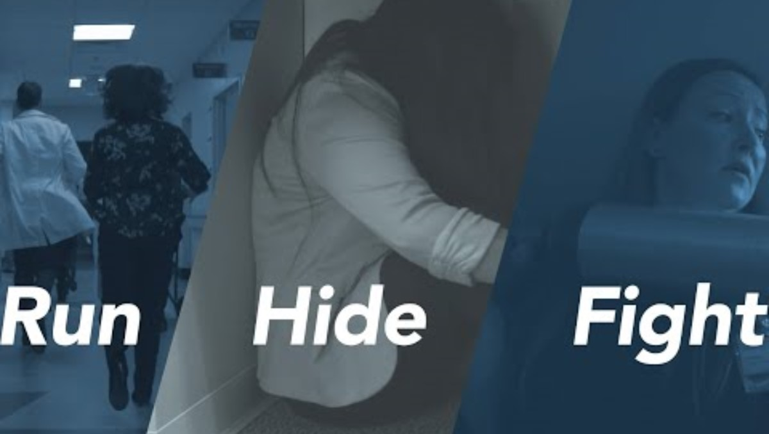
Tying it All Together

Slide 21
REMEMBER, YOUR SAFETY STARTS WITH YOU!
Discuss the topic of active assailant response with your manager and coworkers.
Learn what specific procedures may be in place in your work area such as dedicated safe rooms, escape routes, or maybe even specific words or actions that warn others of a threat.
Sharing ideas and working as a group to protect each other is vital to you and your coworker’s safety.
For more information, visit AvoidDenyDefend.org or email: ADD@alerrt.org
Information credit to ALERRT at Texas State University’s Avoid Deny Defend® training system.

Slide 22
Health Insurance Portability and Accountability Act (HIPAA)

Slide 23
Introduction
Privacy is a patient right. Oaklawn must always keep patient information safe and confidential.
The Health Insurance Portability and Accountability Act, also known as HIPAA is a federal law that protects patient information.
Oaklawn must follow HIPAA because we are a covered entity (health care provider).
HIPAA is broken into two sections, called rules, the Privacy Rule and the Security Rule.
HIPAA applies to all staff, doctors, students, volunteers, Board members, and contractors, also called workforce members.
Breaking HIPAA can mean fines, jail time, or losing your job.

Slide 24
What is protected?
Protected Health Information or PHI is any combination of health information tied to a person, in spoken, written, or electronic form.
The definition of PHI is very specific and isn't always as obvious as you may think.
PHI consists of 18 elements including:
  Personal Information includes names, names of family members, locations or addresses smaller than a state, dates connected to a person that are more specific than a year (like birth date, admission date, discharge date, or date of death).
  Contact information including phone numbers, fax numbers, and email addresses.
  ID Numbers and Codes including Social Security Numbers (SSN), medical record numbers (MRNs) or FINs, Health Insurance ID numbers, bank account information, certificate or license numbers (drivers license or plate numbers), implant or device IDs, serial numbers, and web addresses (URLs or IP addresses).
Personally Identifiable Information or PII is any piece of information that can identify a person by itself or when combined with other information.
Unlike PHI, PII does not have to include health details to be sensitive.
All PHI is PII, but not all PII is PHI.
Everyone who works with or for Oaklawn is responsible for keeping PHI and PII safe and secure.

Slide 25
Patient Rights & NPP (Privacy Rule)
Patients have the right to:
See and get copies of their records.
Ask for corrections.
Pay out-of-pocket and keep it from insurance
Opt out of the hospital directory.
Example: A patient pays cash for counseling and asks insurance not to see it. Oaklawn must honor this request.
Patient Rights are explained in the Notice of Privacy Practices or NPP.
The NPP is not optional. It is required by law.
The NPP explains:
How Oaklawn can use and share a patient’s health information for treatment, payment, and healthcare operations.
The patient’s rights
The limits on when we may share health information without the patient’s permission (for example, to protect safety or meet legal requirements)
As workforce members, your role is to:
Make sure patients receive the NPP when they first come for care.
Be prepared to answer basic questions about what it is.
Direct patients to the Privacy Officer if they want more details or to exercise their rights.

Slide 26
Minimum Necessary
The minimum necessary rule means that when you use, share, or look at a patient’s PHI you should only access or use the smallest amount of information needed to do your job.
The goal is to protect patient privacy by making sure PHI is shared only on a “need-to-know” basis.
Key Points:
  Do not access full records if you only need one piece of information.
  Share only what is needed when talking to coworkers, insurance companies, or others involved in care.
  Limit what you see just because you can open a record does not mean you should.
Examples:
A lab technician runs a blood test and records the test result. They do not need to review the patient’s last office visit.
If billing staff needs the patient’s insurance number, they should not be given the full medical history.
Housekeeping may know a patient’s room number to clean it. They do not need to know the patient’s treatment plan.

Slide 27
Sharing PHI: When is it Allowed?
PHI can be shared without patient consent only if:
  Required by law (e.g., court order if required conditions are met).
  For public health and safety (e.g., disease reporting).
  For worker’s compensation.
  For oversight and compliance (e.g., Office of the Inspector General or Office of Civil Rights).
  For Treatment, Payment, and Healthcare Operations (TPO):
    Treatment: Sharing information between doctors, nurses, and other providers directly involved in a patient’s care.
    Payment: Sending necessary information to insurance companies to get paid for services.
    Healthcare Operations: Quality improvement, audits, or staff training.
Always use the minimum necessary rule.
Patients have the right to read or get a copy of their own medical record. This must be arranged through the Health Information Management (HIM) Department.
  When a patient reviews their record, an Oaklawn staff member must be present. Records may also be reviewed under supervision by someone the patient has authorized, or when the law allows it.

Slide 28
ePHI (Security Rule)
What is ePHI?
Any health information stored, sent, or received electronically (e.g., computers, email, EHR, phones, tablets, fax, etc.).
This includes all PII.
The Security Rule requires Oaklawn to protect ePHI through:
Administrative Safeguards: policies, staff training, and access controls.
Physical Safeguards: locked rooms, screen protectors, and secure workstations.
Technical Safeguards: passwords, encryption, firewalls, and audit logs.
Lost or stolen Devices
Report any lost or stolen device right away, even if you think it had no PHI.
This includes laptops, tablets, smartphones, or USB drives.
As workforce members, your role is to:
Protect ePHI.
Lock computers when stepping away.
Access and use ePHI only when needed for your job.
Never share your password or log in information.
Report suspicious emails or potential breaches as soon as possible by the end of your shift.

Slide 29
Everyday Safeguards
Protect PHI in your daily work. Small actions make a BIG difference.
Conversations
Keep voices down in hallways, elevators, cafeterias, and waiting rooms.
Only talk about patients in private spaces.
Never ask friends, neighbors, or family you see in the hospital, “What are you here for?”
Workstations & Devices
Always log out or lock your computer before stepping away.
Do not share your password or let anyone else use your login.
Never leave screens showing PHI where others can see.
Paper Records
Lock away charts or forms when not in use.
Do not leave documents face-up on desks or in public areas.
Shred or dispose of papers in approved confidential bins.
Phones & Messaging
Never text PHI or use personal apps or social media (WhatsApp, Messenger, Gmail, SMS texting).
Be careful with voicemail: leave only what is necessary (e.g., “Please call back,” not diagnoses or test results).
Examples:
Staff leaves detailed voicemail with patient’s cancer diagnosis= violation.
Doctor discusses patient’s test results in an elevator= violation.
Staff leaves a computer logged in at the nurses’ station when walking away= violation.
IT staff uses secure Oaklawn laptop to fix a EMR issue= OK.
Staff uses SMS texting to send a patient’s test results= violation.

Slide 30
Social Media, Technology, & Personal Devices
Never post or share any patient information on social media.
  This includes Facebook, Instagram, Snapchat, TikTok, X (Twitter), or any other platform.
Do not use personal messaging apps to talk about or to patients.
  This includes WhatsApp, Facebook Messenger, iMessage, or Gmail. Even if you don’t use a patient’s name, you can still break the rules.
Never take pictures of patients or charts using personal devices, unless you are using a secure Oaklawn approved application (e.g., AthenaText, AthenaCapture)
Using Public Wi-Fi or Personal Devices
  Never use public Wi-Fi (like coffee shops or airports) to access PHI.
  Only use Oaklawn-approved devices and secure networks.
  Do not save patient information on your personal phone, tablet, or computer.
Examples:
  Staff posts “Gunshot victim in ER today”= violation, even without name.
  A staff member texts a lab result to a doctor using WhatsApp= violation.
  A staff posts a photo of a patient’s thank-you card on Instagram with patient name= violation.
  Staff posts a photo at work where a computer screen shows PHI in the background= violation.

Slide 31
Breach Notification
  What is a Breach?
  A breach happens when PHI is seen, used, shared, or taken by someone who should not have it.
  A breach also includes times when workforce members do not follow the minimum necessary rule and access more than they should.
  Your Job
  If you think a breach has happened, you must report it right away. No later than the end of your workday.
  Do not try to hide it or fix it yourself. Only the Privacy and Security team can confirm if a breach has occurred.
  How to Report
  Privacy Officer: Brianna Hayes
    Ext. 7576, Email: askcompliance@oaklawnhospital.com
  Security Official: Lee Masterson
    Ext. 3920, Email: helpdesk@oaklawnhospital.com
  If you are not sure, tell either one or both.
  Why Reporting Matters
  The law says patients must be told quickly if their information was wrongfully shared.
  Waiting to report can hurt the patient and put Oaklawn at risk of fines.
  Fast reporting keeps patients safe and shows we take privacy seriously.
  Failing to report a suspected breach is the same as helping those who misuse patient information. Quick reporting helps us protect patients and limit damage.

Slide 32
Monitoring & Sanctions
What is a Sanction?
  A sanction is a penalty or punishment given when someone breaks a rule, law, or policy.
Oaklawn tracks and audits every time PHI is opened.
  Each time you view, change, or share a chart there is a log of the activity. Compliance and IT review these logs regularly.
Just because you can, doesn’t mean you should.
  Having the ability to open a record does not mean you have permission.
  Only access PHI if you need it to do your job.
Penalties for Wrongful Access
  Civil fines: Up to $25,000 per year for repeat violations.
  Criminal fines: Up to $250,000 per case and possible jail time for intentional misuse.
  Oaklawn sanctions: May include retraining, suspension, termination of employment, or reporting to licensing boards.

Slide 33
Other Considerations
Michigan Law
  The Mental Health Code gives mental health treatment records extra protection. Records can only be shared with patient consent, a court order, or in limited emergencies,
  Reproductive Healthcare records have additional protections in certain situations.
  When Michigan law is stricter, we must follow the stricter rule.
Oaklawn’s Policy
  Oaklawn does not allow anyone to access their own records or the records of their immediate family.
  Simply being related to or knowing a patient does not give you permission to look at their record.
  If you need to see your own medical record or a family member’s record, you must go through the Health Information Management (HIM) like any other patient.
  All record access is logged and audited. Unauthorized access will be treated as a policy violation.

Slide 34
Key Takeaways
Privacy is a patient right.
You must always keep PHI and PII safe.
Only use or share the smallest amount of PHI needed for your job.
Treatment, payment, operations, required by law, public health, and oversight.
Protect electronic PHI with passwords, encryption, locked screens, and secure devices.
Keep voices down, lock computers, securely shred paper records, never text or post PHI.
Never share login information or passwords or allow someone to use your credentials. You are responsible for all actions under your login.
Report any suspected breach immediately (by the end of your shift).
Failing to report a suspected breach is the same as helping those who misuse patient information.
Monitoring & Sanctions: All access is tracked. Wrongful access can lead to fines, job loss, or criminal penalties.
Some records (mental health & reproductive health) have stricter protections than HIPAA. Always follow the stricter rule.
Never access your own or family members’ charts.

Slide 35

Safety on Site
Keeping yourself Safe
Computer Based learning (CBL) 2026

Slide 36
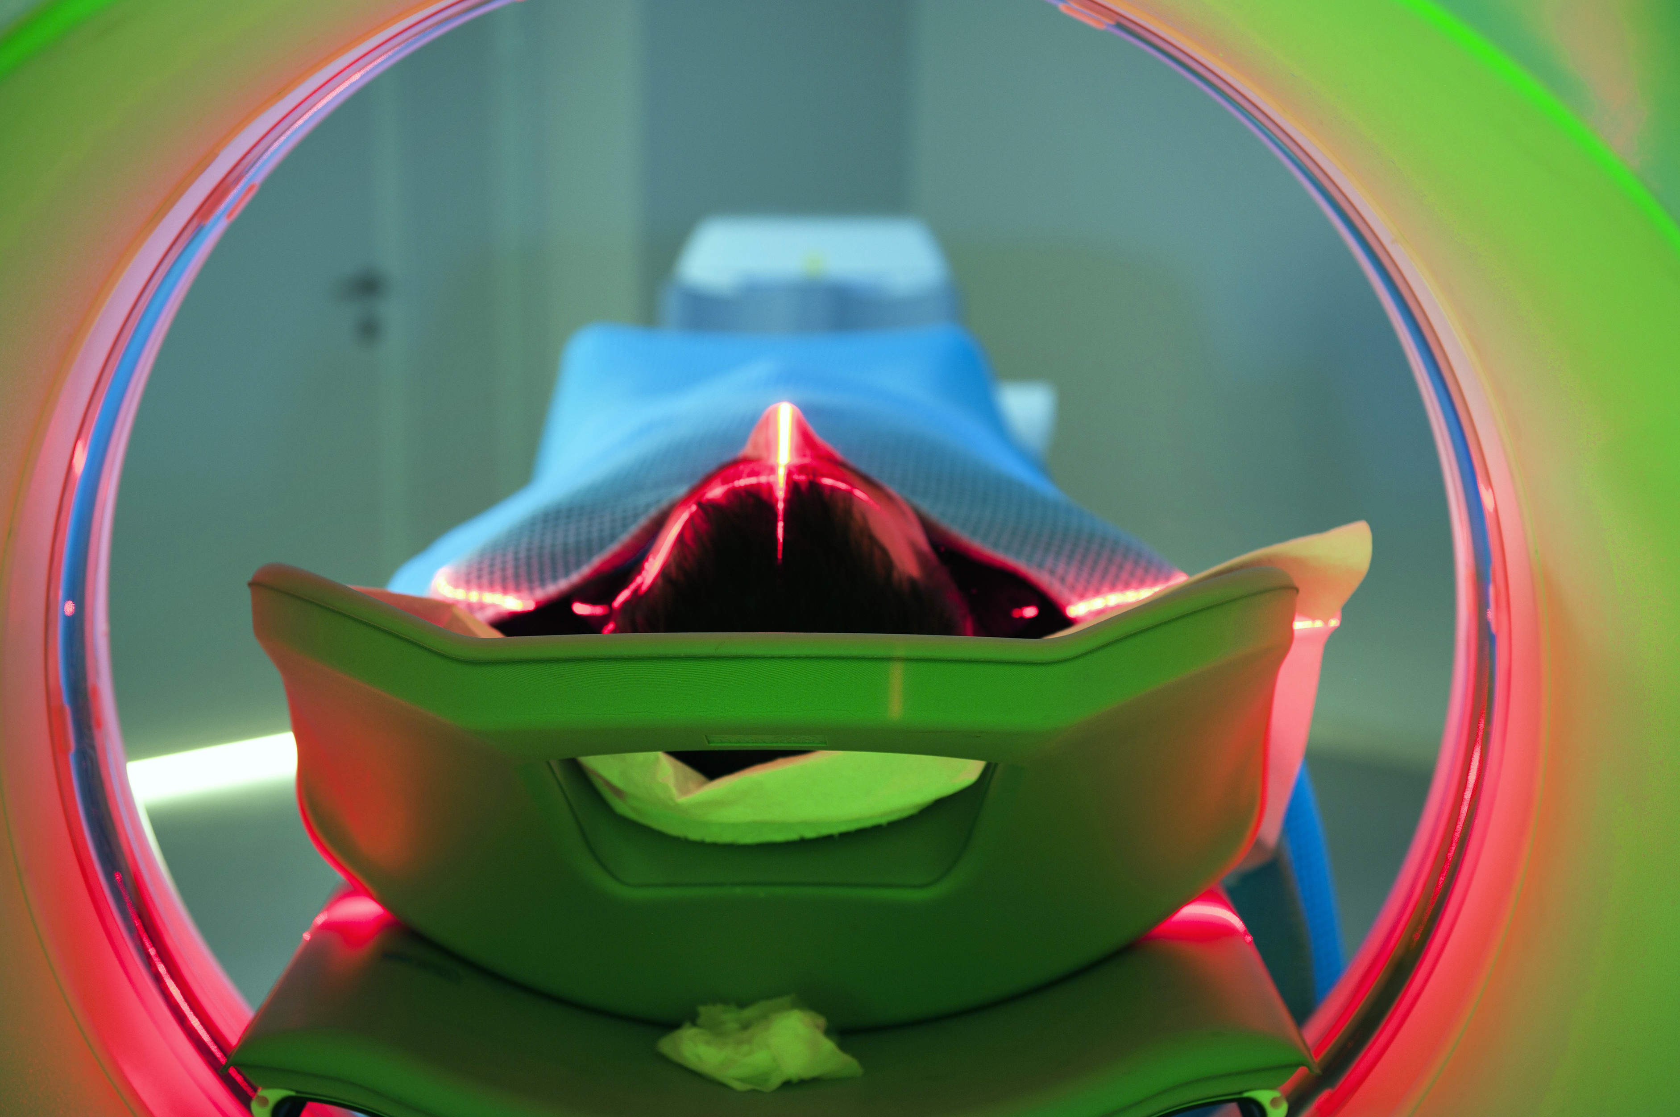
Topics to be Discussed
Safety Management
Security
Medical Equipment
Utilities Management
Hazardous Communications
Medical Waste

Slide 37

Safety Management
Life and Fire Safety Management

Slide 38
Overview
The hospital shall provide a Safety Management System that maintains safe and adequate facilities for its services.
Members of the Safety Committee conduct regular environmental tours to identify and evaluate environmental deficiencies including, but not limited to:
  Unsafe practices
  Security deficiencies
  Hazardous materials and wastes
  Fire Safety
  Medical equipment
  Access to utility systems
  Staff knowledge on Safety

Slide 39
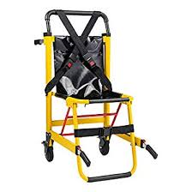
Life Safety
Det Norske Veritas (DNV) and other federal groups require health care facilities to meet the Life Safety Code.
The hospital has a written Fire Control Plan that contains provisions for:
  Prompt reporting of fires
  Extinguishing fires
  Protecting patients, personnel, and guests
  Evacuation
  Cooperation with firefighting authorities
Alternative Life Safety Measures
(ALSM)
When a health care facility is constructing new buildings or remodeling, it must comply with alternative life safety measures.
The alternative measures are needed since the building may not meet the typical fire safety requirements during construction.

Slide 40
Fire Safety
The roles of all employees, physicians, volunteers, and students at and/or near the point of fire origin are defined. Follow the R.A.C.E. acronym if there is a fire or suspected fire:
Rescue anyone directly affected by the fire.
Alarm/Activate by pulling fire alarm pull stations.
Contain or close doors to contain smoke and the products of combustion.
Extinguish small controllable fires or Evacuate patients and personnel.
PASS
Basic directions for using a fire extinguisher:
  Pull pin on handle of extinguisher
  Aim nozzle at the base of the fire
  Squeeze handle on extinguisher
  Sweep at the base of the fire

Slide 41

Security
Management of Security

Slide 42

Security
The hospital has developed a Security Management System that provides a secure environment including, but not limited to:
Key System
Badge Access
Pediatric and Infant Alert System
Camera Control
Visible Security Personnel

Slide 43
Security Management
The Security Management system shall address issues related to:
  Abduction
  Elopement
  Workplace Violence
  Investigation of Property Losses

Slide 44

Medical Equipment
What Constitutes Medical Equipment
Reporting malfunction

Slide 45
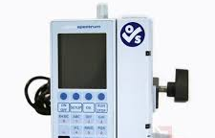
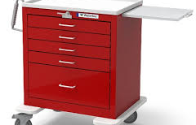
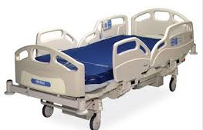
Medical Equipment
A medical device is any instrument, apparatus, or another article that is used to prevent, diagnose, or treat a disease.
  Medical devices include but are not limited to:
    Defibrillators
    Monitors
    Ventilators
    Infusion Pumps
    Hospital Beds

Slide 46
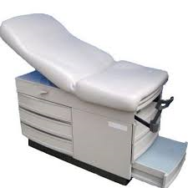
Medical Equipment
Healthcare providers should be familiar with hazards associated with the medical equipment they use, as well as with any requirements of reporting malfunctions.

Slide 47
Reporting a Medical Equipment Malfunction
Access the LINKS folder on your desktop and select Bio-Med Web Request to open the request form.
Fill in the appropriate information.
The asset number is located on the piece of equipment.
Remove the item from service and tag it with red Repair Status form.

Slide 48
Utilities
Emergency Power
Electrical Safety

Slide 49
The hospital shall require a Utility Management System that provides for a safe and efficient facility.
As part of this, we minimize the risk of utilities failure within the facility including:
    Communications
    Electrical Systems
    Fire detections and Suppression
    Heat and Air Conditioning
    Medical Gas and Vacuum Systems
    Water
Utilities

Slide 50
Emergency Power
In addition to emergency power for:
Alarm Systems
Communication Systems
Exit Sign Lighting
The facility’s emergency power must also maintain essential services when the normal power system is interrupted.
These services include:
  Blood bank and tissue storage
  Emergency care and operating rooms
  Medical air and vacuum systems
  Life-support equipment
  Obstetrics/Newborn nursery
  Air handling unit for critical areas
When normal power is interrupted, the emergency power system takes over. The emergency system is powered by diesel and natural gas generators.
Receptacles for emergency power are red.
Receptacles for normal power are ivory.
Exit signs are illuminated when emergency power is on.

Slide 51
Electrical Safety Guidelines
Health care workers often operate electrical equipment. When you are called upon to do so, follow these safety guidelines:
  Use only electrical equipment that you have been trained to use.
  Keep electrical cords or connections away from water and other liquids.
  Do not operate electrical appliances inside an oxygen canopy.
  Plug only one piece of medical electronic equipment into each outlet.
Electrical Safety

Slide 52

Hazard Communications
Safety Data Sheets
Chemical Labeling
Coding System
Chemicals

Slide 53

Hazard Communication
Hazard Communication Programs help reduce the risk of workers being exposed to chemicals.
Healthcare facilities must comply with the hazard communication program as required by OSHA by doing the following:
  Director training of employees regarding the chemicals they use within their department
  Use labels, signs, and detailed chemical information provided on the Safety Data Sheets (SDS)

Slide 54
Safety Data Sheet (SDS)
A safety data sheet (SDS) is a form issued for every potentially hazardous chemical used in the workplace. These are available on the Delivered Applications window in a folder titled Safety Data Sheets.
Each SDS contains information about the chemical, including:
  Identification
  Physical and chemical properties
  Hazard identification
  Stability and reactivity
  Composition/information on ingredients
  Toxicological information
Safety Data Hotline
In addition to the forms available on the Delivered Applications window, they can be obtained by calling the SDS Hotline # 1-800-451-8346.
Info to have when calling: Product name and number, Manufacturer Name, Manufacturer Phone Number, and UPC Code.
Assistance may also be received from the MIOSHA General Industry Safety and Health Division at (517)284-7750.
  First aid measures
  Ecological information
  Fire-fighting measures
  Disposal consideration
  Accidental release measures
  Transport information
  Handling and storage
  Regulatory information
  Exposure controls/personal protection
  Other information
Person responsible for SDS at Oaklawn / Contact information
Katie Steiner, MSN, RN – Regulatory & Accreditation Manager / Safety Officer
Email: ksteiner@oaklawnhopsital.com
Phone: 269-789-4271 x3174

Slide 55
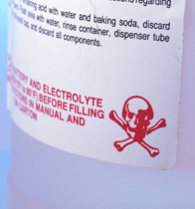
Chemical Labeling
Chemicals must be labeled with:
Common name
Chemical name
Fire, spill, and leak instructions
Handling and storage instructions
Hazard statement explaining the physical and health hazards of the chemical
Instructions in case of exposure
Name, address, and phone number of the manufacturer
Precautions to be taken when working with the chemical
Signal word (such as warning, caution, or danger)
Pictograms
All hazardous chemical containers must have labels so that the content can easily be identified and to let employees know about any hazard warnings.

Slide 56
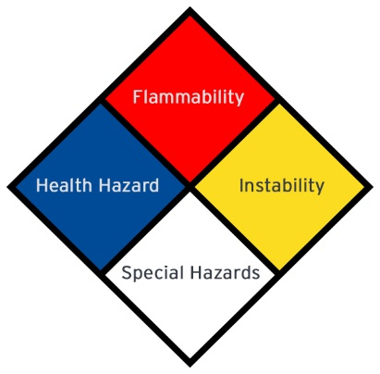
Hazardous Material Placard Systems
The labeling on the different placards is as follows:
  Flammability hazards are signified with a red diamond.
        4 – Will vaporized and readily burn at normal temperatures
        3 – Can be ignited under almost all ambient temperatures
        2 – Must be heated or high ambient temperature to burn
        1 – Must be preheated before ignition can occur
        0 – Will not burn
  Instability are indicated by a yellow diamond.
        4 – May explode at normal temperatures and pressures
        3 – May explode at high temperature or shock
        2 – Violent chemical change at high temperatures or pressures
        1 – Normally stable. High temperatures make unstable
        0 - Stable
  Specialized chemical hazards are signified with a white diamond.
        OX – Oxidizing
        SA – Simple asphyxiants
        W – Reacts violently or explosively with water
  Health hazard rating is indicated in the blue diamond
        4 – Can be lethal
        3 – Can cause serious or permanent injury
        2 – Can cause temporary incapacitation or residual injury
        1 – Can cause significant irritation
        0 – No hazard
A hazardous material placard system is used to assist in identifying a hazardous chemical during use, storage, shipping, and transport.
The external labeling or placard system requires that symbols be posted in visible locations to warn and assist emergency responders in case an accident occurs.

Slide 57

Medical Waste
What is Considered Medical Waste?
What to do when a Patient is Exposed?

Slide 58
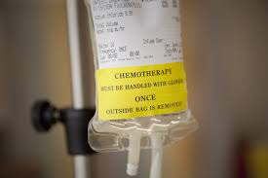

Radioactive Materials
These are handled subject to the Department of Public Health Radiation Control License and the Radiation Safety Officer manages their safety.
Material Safety
  Chemotherapeutic Materials
  Chemotherapeutic residual waste is handled as part of the Regulated Medical Waste stream, with additional labeling to assure appropriate incineration is completed as final destruction.

Slide 59
Infectious and
Regulated Medical Waste
Infectious and regulated medical
waste includes, but is not limited to:
  Used Needles
  Blue pad saturated with blood/body fluid
  Used culture tubes
  OR sponges saturated with blood/body fluid
  Dressings (various sized) saturated with blood
Items not considered regulated medical waste:
  Basins: Bath and Emesis
  IV tubing without needle
  Unused culture tubes
  Shave prep tray without razor

Slide 60
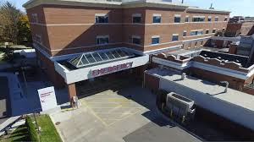


Patient Exposure
Patients can present to our facility, via any entrance, with a variety of exposures (Radiation, Ebola, Anthrax, Methamphetamine, etc.)
If a patient presents to your area with any of the above exposures, stop the spread by keeping them contained and notifying the Emergency Department.

Slide 61
INFECTION PREVENTION & CONTROL: The Basics

Slide 62
Exposure Control Plan
The Bloodborne Pathogens Exposure Control Plan (ECP) can be found in Policy Stat. This plan provides guidance for following:
Determination of employee exposure risk (based on job duties)
Exposure control methods including standard precautions, engineering and work practice controls, PPE and housekeeping
Provision for vaccination against Hepatitis B
Processes for bloodborne pathogen post-exposure evaluation and follow-up, as well as investigation into circumstances surrounding an exposure incident.
Direction for communication of hazards to and training for employees
Requirements for record-keeping
The MIOSHA Bloodborne Pathogen Infectious Disease Rule is attached to this policy in Policy Stat.
Employees may access the ECP at all times from the Oaklawn PolicyStat website. Questions should be directed to the employee’s direct supervisor or manager, the Infection Prevention & Control Manager, and/or the Employee Health department in Human Resources.

Slide 63
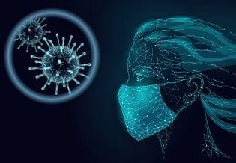
How are infections spread?
Infections happen when germs, or microbes, are passed from a source to a susceptible person.
Microbes don’t generally move by themselves. They need something – people, the environment, equipment, and/or other means – to carry them to a person who can get sick. Transmission occurs when the susceptible person is touched, splashed, sprayed, or inhales the right amount of germs to make them sick.
Transmission of an infection can be stopped by breaking the chain of infection.

Slide 64
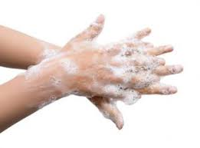
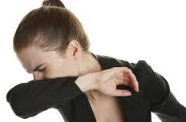
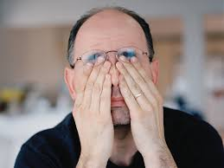

HOW WE PROTECT OURSELVES AND OTHERS
Handwashing
The number one way to prevent transmission of infections.
Cover your Cough
Coughing into your elbow or into a tissue will help stop the spread of droplets.
Don’t Touch Your Face without Cleaning Your Hands
Your eyes, nose, and mouth are the easiest points of entry for infectious diseases. By touching these areas with dirty hands – even if you can’t see the dirt - you are taking the germs where they want to go.
Stay home when you are ill!

Slide 65


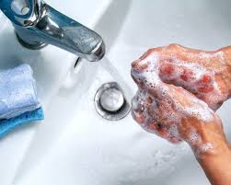
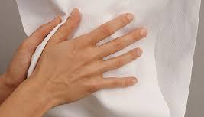
Handwashing Basics Soap and Water
Step 1: Wet hands under faucet.
Step 2: Apply soap to palms of hands and rub palms, backs of hands, between the fingers and halfway up the wrist. Scrub all areas thoroughly including nail beds and under jewelry.
Step 3: Scrub hands for 15-20 seconds. Songs to sing: Happy Birthday or Twinkle Twinkle Little Star (2 times), ABCs.
Step 4: Rinse hands angled down into the sink. Turn off the water using a clean paper towel, discard.
Step 5: Using clean paper towels, thoroughly dry hands.

Slide 66

Handwashing Basics:
Alcohol-based Hand Sanitizer (ABHS)
Step 1:
Apply ABHS to one hand. Apply enough to fully sanitize both hands.
Step 2:
Rub hands together covering the palms, back of hands, between fingers and halfway up the wrist.
Pay special attention to nail beds and under jewelry.
Rub until the product is completely dry (about 15-20 seconds).
*If this process does not last 15-20 seconds reapply sanitizer and see Step 1.
DO NOT:
Use ABHS if your hands are visibly soiled. Wash visible soil with soap and water.
Discard any amount of hand sanitizer off your hands prior to step 2.
Rub your wet hands on your clothing or any other surfaces or use a paper towel to dry.

Slide 67
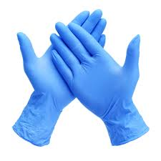
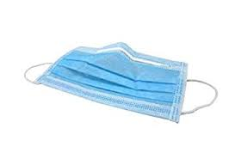
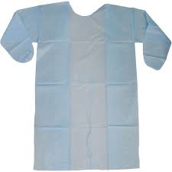
Personal Protective Equipment (PPE)
Gloves: Wear them whenever there is risk of contact with blood, body fluids, or other possibly infectious materials.
Always wear for Contact Precautions (Isolation).
Gowns: Used to protect clothing from contamination. Gowns need to be worn whenever there is a risk for splatter of blood or body fluids and every time upon entering a Contact Precautions (isolation) room/area.
Procedure/Surgical Mask: Protect both patients and staff from the transfer of respiratory droplets created by coughing, sneezing, or talking or singing.
Masks & Eye Protection:
Wear them when there is a potential for contact with droplets or respiratory secretions.
Eye protection may be goggles, face shields, or shields attached to masks.
Droplet Precautions, consider for Airborne Precautions.
Procedure Masks are single use.

Slide 68
Welcome to Oaklawn!

